Slide 1


SWIGGY DATA ANALYSIS
SUBMITTED BY:
M. BALAJI

Slide 2
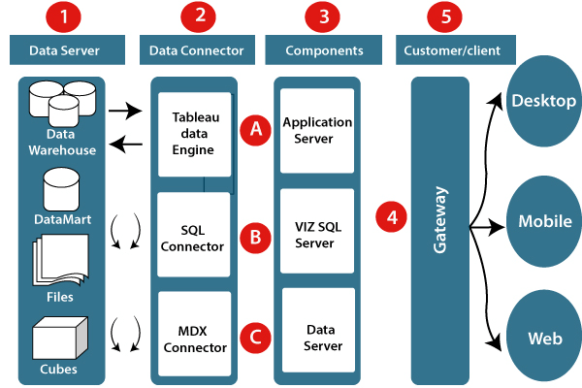
ARCHITECTURE

Slide 3
ETL OPERATIONS
Cleaning poorly formatted columns from the extracted raw data.
Skipping rows with Nan values.
Removing duplicated rows.
Changing the data types for necessary columns.

Slide 4
INSIGHTS

Slide 5
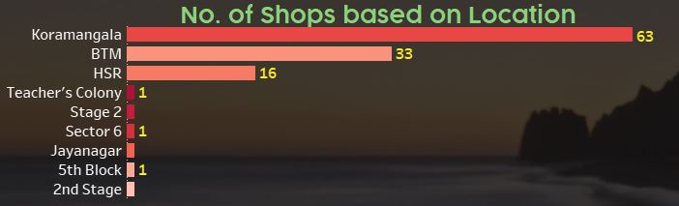
Locations with more number of shops are:
Koramangala - 63
BTM - 33
HSR - 16

Slide 6
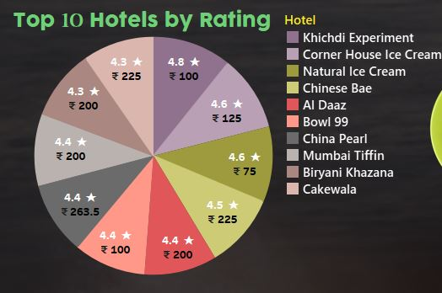
Khichdi Experiment has highest rating of 4.8 with a Price of 100/- per item.
Corner House Ice Cream and Natural Ice Cream are the shops with 4.6 rating, with the prices of 125/- and 75/-

Slide 7
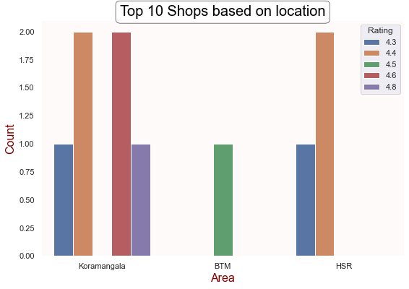
Out the top 10 shops six shops are located in Koramangala.
Two shops are located in HSR .
Only one shop is located in BTM.

Slide 8
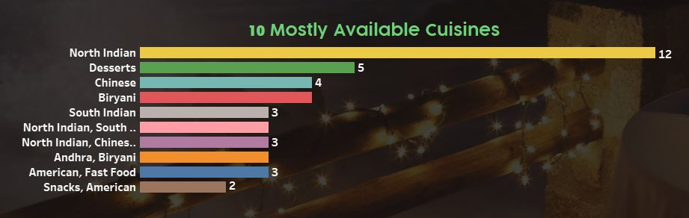
From this page we get to know about top 10 mostly available Cuisines.
North Indian Cuisine is mostly available in 12 Hotels.

Slide 9
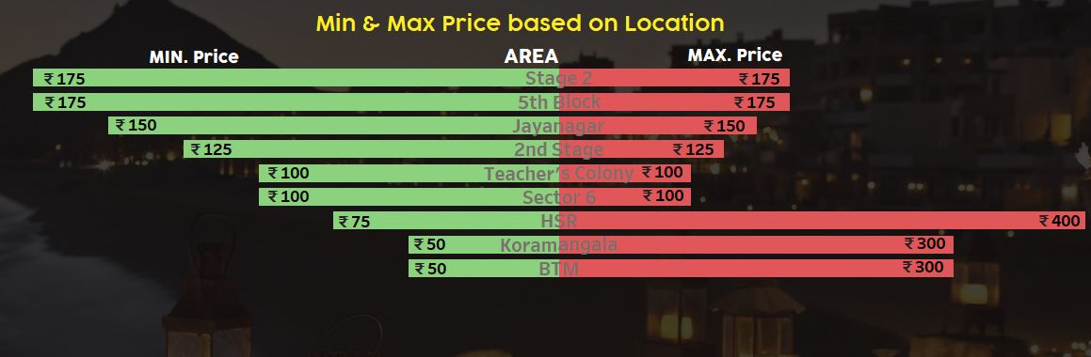
Hotels in Stage-2 Area have highest minimum of 175/- per item
Hotels in Koramangala & BTM Area have least minimum of 50/- per item
Hotels in HSR Area have high maximum of 400/- per item
Hotels in Teacher's Colony & Sector-6 Area have less maximum of 100/- per item

Slide 10
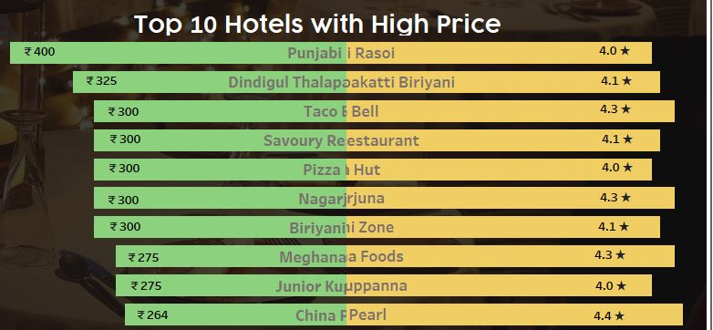
In top 10, Punjabi Rasoi Hotel has the highest price of 400/- per item
China Pearl Hotel stood in 10th place with a price of 264/- per item

Slide 11
Q & A
What's the Source of the Data - Collected from Given Data Set
Which tools you are used in this entire project – Tableau Public
How did you deploy the report - The report was deployed in my Tableau Public Server
What was the type of Data - Numerical and Categorical Values

Slide 12
THANK YOU

